Slide 1
AUTOMATED CLASSIFICATION OF LIGHT CURVES OF ECLIPSING BINARIES USING Ann
Michał Drzał
Dawid Pazik

Slide 2
Project is sIMPLIFIED implementation of this paper: http://arxiv.org/pdf/1407.0443v1.pdf FOR abstract check: http://arxiv.org/ABS/1407.0443v1.pdf

Slide 3
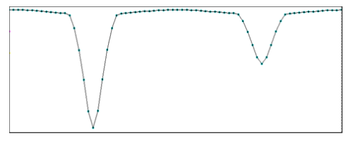
LIGHT CURVE
Luminosity of a single star or a star system in time domain
Usually shows some kind of a periodic behaviour
The more points near the dip in brightness the better

Slide 4
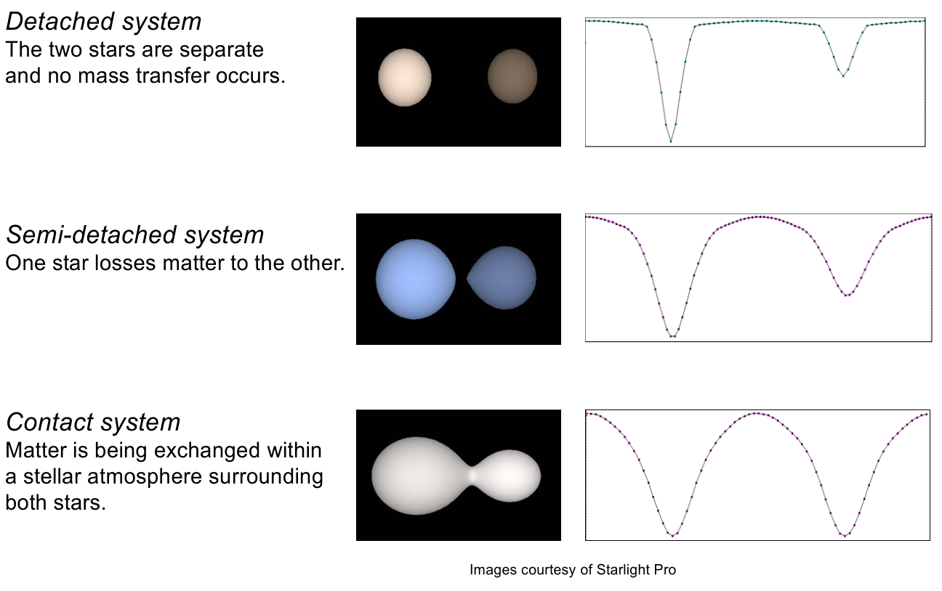
ECLIPSING BINARIES (classes)

Slide 5
Data source : the ASAS CATALOGUE http://www.astrouw.edu.pl/asas/?page=acvs DATA iS HIGH-DIMENSIONAL ANN DON’T LIKE THAT DATA COMPRESSION

Slide 6
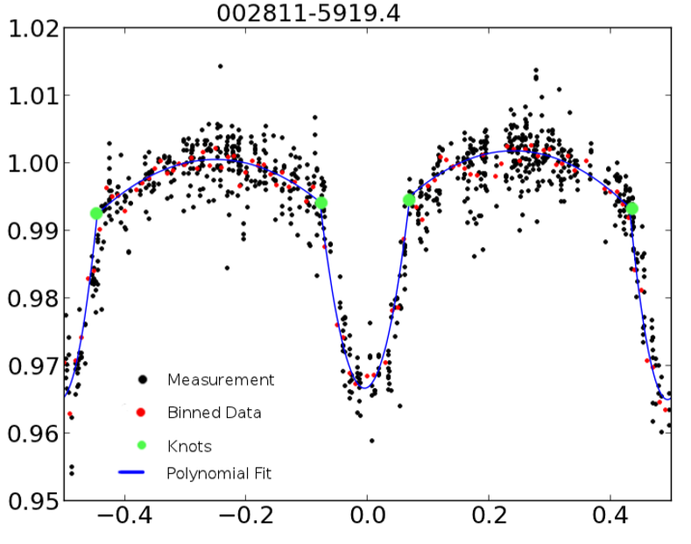
SPLINES
APPROXIMATE THE shape of light curve with SPLINE using third degree polynomials
USE coefficients of those polynomials as input to the neural net

Slide 7
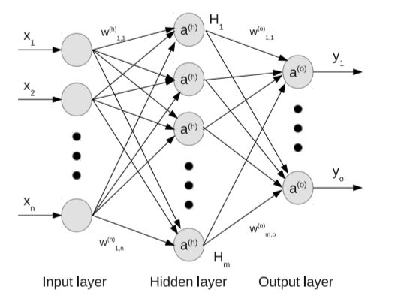
ARTIFICIAL NEURAL NET
Simulates behaviour of real neural nets (brains)
Weighted network of neurons
Different topologies

